Slide 1
DBT and Snowflake
Kerry Nakayama

Slide 2

Objectives
Data Build Tool
dbt core vs dbt cloud
How not to talk about dbt
Where dbt helps
dbt cloud
dbt as an IDE
dbt Projects
dbt Models
What else can it do
Jinja
Documentation
QA and testing
Repositories
Git Pull Requests & Push
Best Practices

Slide 3

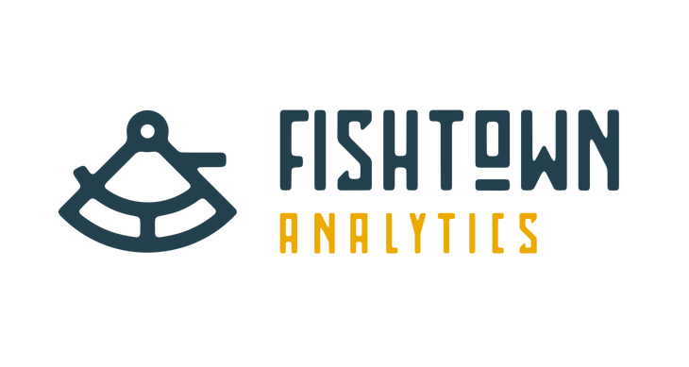
Data Build Tool
As a dbt user, your main focus will be on writing models
reflect core business logic
What is a model?
Tables
Views
Object Oriented SQL
Imagine a huge subquery or 600 line CTE model
Break it into pieces
Know the failure points
Invariant Testing
Notes:
and views, or to define the order of execution of your models. Instead, dbt handles turning these models into objects in your warehouse for you
wraps your select query in a statement to create a new, or update an existing, relation
Since your company wants you all to write in CTEs you should focus on ephemeral (short term)
In other words based on the queries that you write it will realize certain components need to be completed first before the model can be built
for example say you are cleaning a transactions table you might have the orders all in one table and the payments in another and will need to join the two tables together.
Doing data analytics/engineering work as it were software engineering

Slide 4
DBT
dbt Core is the software that takes a dbt project (.sql and .yml files) and a command and then creates tables/views in your warehouse. dbt Core includes a command line interface (CLI) so that users can execute dbt commands using a terminal program. dbt Core is open source and free to use.
dbt Cloud is an application that helps teams use dbt. dbt Cloud provides a web-based IDE to develop dbt projects, a purpose-built scheduler, and a way to share dbt documentation with your team. dbt Cloud offers a number of features for free, as well as additional features in paid tiers

Slide 5


But what is it?
Until you drink the ”Kool-Aid” it is hard to understand in abstract
Model, YAML code, Testing, etc
So dbt will Fix everything…
If you have dbt, tests and docs will be created for everything
Team needs to put tests and docs together to build confidence in the data and dbt is a tool that can help
Notes:
This make sense in theory but why not use what companies have been doing for years
Bc most people are lazy and don’t implement it
Don’t forget you still have to write all the docs and tests
It will be a cultural change

Slide 6
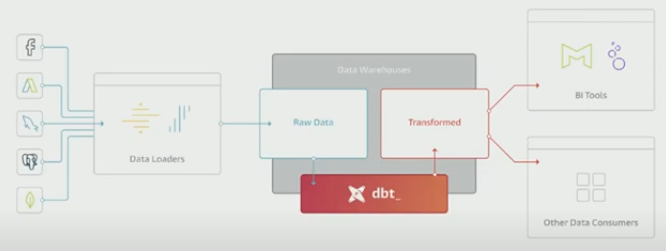
Where dbt helps

Slide 7
dbt Cloud Ships With
dbt handles boilerplate code to materialize queries as relations
A materialization represents a build strategy for your select query
dbt ships with the following built-in materializations:
view (default): The model is built as a view in the database.
table: The model is built as a table in the database.
ephemeral: The model is not directly built in the database but is instead pulled into dependent models as common table expressions.
incremental: The model is initially built as a table, and in subsequent runs, dbt inserts new rows and updates changed rows in the table
Notes:
Dbt cloud is a user friendly tool that take the open source tool so you no longer need to implement command line code
You can still run this code on the command line and many times this might be faster for certain items

Slide 8
dbt as an IDE
The dbt Integrated Development Environment (IDE) provides a realtime editing and execution environment for your dbt project.
In the dbt IDE, you can write, run, test, and version control the code in your dbt project from your browser -- no command line use required.
The IDE leverages the open-source dbt server to intelligently recompile only the parts of your project that have changed
Notes:
This brings the cycle time for dbt project development down from minutes to seconds.
Leverage git directly from the dbt IDE to version control your code from your browser. You can branch, commit, push, and pull code with a couple of clicks - no command line required.

Slide 9
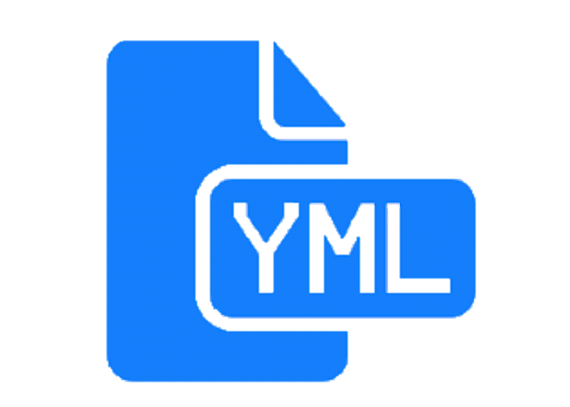
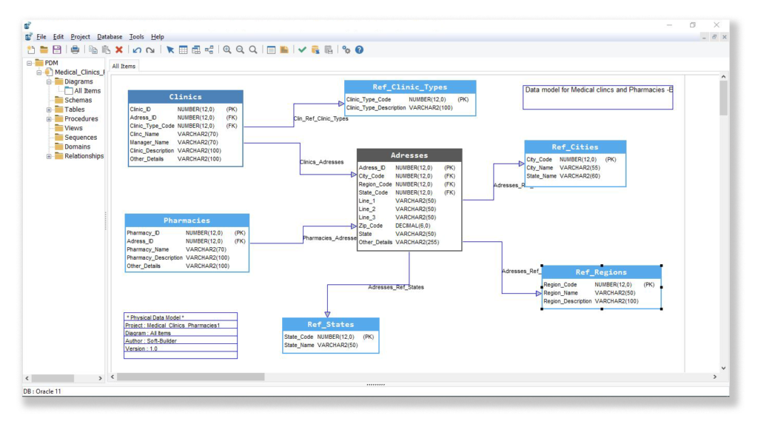

dbt Projects
Project formats have two main types
.yml
Essentially you config files
Help with ordering to create models
.sql
Model files are written in SQL
Don’t forget to COMMIT changes
dbt acts like a repository for your work
Version control
Keeps up-to-date code
Notes:
Remember in mod 1 we discussed config files
The files can contain a multitude of other resources like snapshots, seeds, tests, macros, documentation, or sources

Slide 10
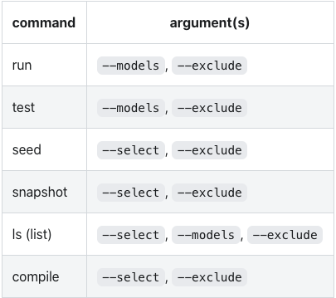
Rich Model Selection Syntax
dbt's model selection syntax makes it possible to run only specific resources in a given invocation of dbt
While dbt run executes all code you might need to only run subset
Helps with testing
Optimizes dev on new models
Notes:
Use flags –models –exclude
a package name
a model name
a fully-qualified path to a directory of models
a tag selector
a source selector
a path selector
Dbt uses short hand to run code
+ run children or parents of any select model

Slide 11
Model Examples

Slide 12
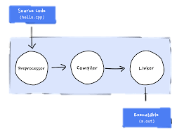
What else can dbt do
Jinja – code compiler - Light weight templating language
It takes loops and if statements and enables repeated SQL
Documentation – tracking on the deployed code
write, version-control, share documentation
QA and testing – set validation/integrity checks for your code
Seed file loader – mapping more readable values
Load data that doesn’t change to map to incoming data for comparisons
Notes:
Controls structures
Revenue forecasts/ goals compared to incoming numbers
Country codes that need to be mapped
Understanding raw data
Snapshot to compare old data

Slide 13

Making code “DRY” (don’t repeat yourself)
Using loops for repeated code that iterates through a list
Use macros to return lists
{%Macro get_payment_methods () %}
Use macros that have already been solved in dbt-utils
{% set payment_methods = ["bank_transfer", "credit_card", "gift_card"] %}
SELECT order_id,
{% FOR payment_method IN payment_methods %}
SUM(CASE WHEN payment_method = '{{payment_method}}’ THEN amount END) AS {{payment_method}}_amount,
{% endfor %}
SUM(amount) as total_amount
FROM {{ ref('raw_payments') }}
GROUP BY 1
Notes:
Jinja is a web template engine for the Python programming language. It was created by Armin Ronacher and is licensed under a BSD License. Jinja is similar to the Django template engine but provides Python-like expressions while ensuring that the templates are evaluated in a sandbox
select
order_id,
sum(case when payment_method = 'bank_transfer' then amount end) as bank_transfer_amount,
sum(case when payment_method = 'credit_card' then amount end) as credit_card_amount,
sum(case when payment_method = 'gift_card' then amount end) as gift_card_amount,
sum(amount) as total_amount
from {{ ref('raw_payments') }}
group by 1
select
order_id,
{% for payment_method in ["bank_transfer", "credit_card", "gift_card"] %}
sum(case when payment_method = '{{payment_method}}' then amount end) as {{payment_method}}_amount,
{% endfor %}
sum(amount) as total_amount
from {{ ref('raw_payments') }}
group by 1
This list is short but imagine having a huge list of payment types or maybe user agents
Create a macro from another model that may contain the entire list and use it instead of hardcoding the list. Helps with updates to the list without having to go in and change the code.
Imagine having to remember all the locations this code might be used and you have to change all of them.
Whenever you're trying to solve a problem that you think others may have solved previously, it's worth checking the dbt-utils package to see if someone has shared their code!

Slide 14

YAML & Jinja Style Guides
YAML
Indents should be two spaces
List items should be indented
Use a new line to separate list items that are dictionaries where appropriate
Lines of YAML should be no longer than 80 characters.
Jinja
When using Jinja delimiters, use spaces on the inside of your delimiter, like {{ this }} instead of {{this}}
Use newlines to visually indicate logical blocks of Jinja

Slide 15
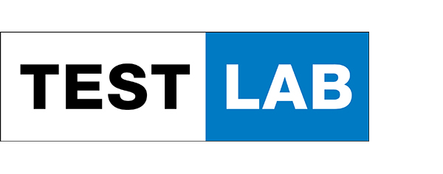
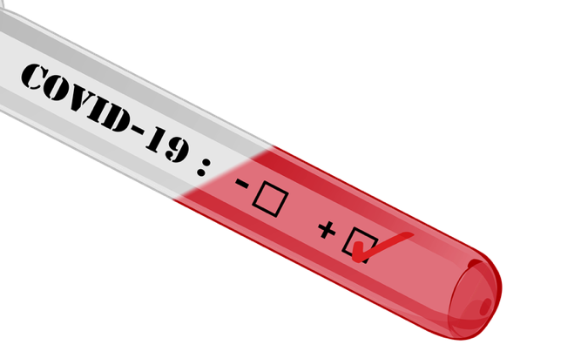
Tests
Adding validations to your data in dbt during the Transformation step
Two types of test
Schema Tests
Done in the config file and returns records if they do not pass otherwise 0
Schema tests are added as properties for an existing model (or source, seed, or snapshot)
dbt ships with the unique, not_null, accepted_values and relationships tests
Data Tests
a select statement that returns 0 records when the test is successful. Note: this differs from schema tests that return the number 0.
Data tests are defined in .sql files, typically in your tests directory. Each .sql file contains one data test / one select statement:
To only run data tests, run dbt test --data
Notes:
unique: the order_id column in the orders model should be unique
not_null: the order_id column in the orders model should not contain null values
accepted_values: the status column in the orders should be one of 'placed', 'shipped', 'completed', or 'returned'
relationships: each customer_id in the orders model exists as an id in the customers table (also known as referential integrity)
o add a schema test to your project:
Add a .yml file to your models directory, e.g. models/schema.yml, with the following content (you may need to adjust the name: values for an existing model)
Run the dbt test command:
select count(*) as validation_errors
from (
select
order_id
from analytics.orders
where order_id is not null
group by order_id
having count(*) > 1
) validation_errors
-- Refunds have a negative amount, so the total amount should always be >= 0.
-- Therefore return records where this isn't true to make the test fail
select
order_id,
sum(amount) as total_amount
from {{ ref('fct_payments' )}}
group by 1
having not(total_amount >= 0)
We recommend that every model has a test on a primary key, that is, a column that is unique and not_null.
We also recommend that you test any assumptions on your source data. For example, if you believe that your payments can only be one of three payment methods, you should test that assumption regularly — a new payment method may introduce logic errors in your SQL.
In advanced dbt projects, we recommend using sources and running these source data-integrity tests against the sources rather than models.

Slide 16
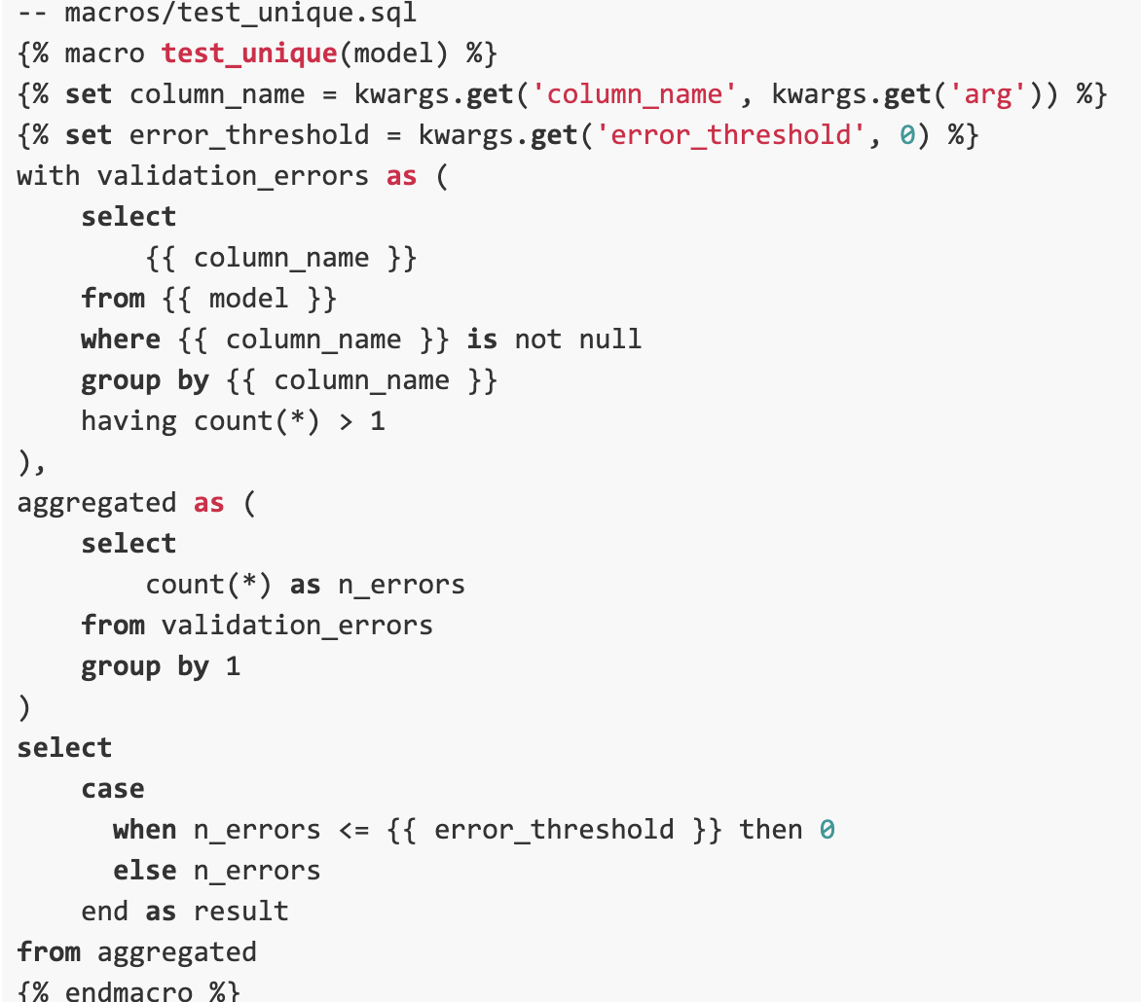
Custom Tests
dbt ships with Not Null, Unique, Relationships, and Accepted Values schema tests
To define your own schema tests, simply create a macro called test_<test_name>
Examples of custom tests
Creating thresholds of % of data being bad

Slide 17

Repositories
Create repositories that directly connect to dbt
Adding a repository is as simple as inputting the URL
Github vs Gitlab
Notes:
Authentication Levels
With GitLab you can set and modify people’s permissions according to their role. In GitHub, you can decide if someone gets a read or write access to a repository
With GitLab you can provide access to the issue tracker (for example) without giving permission to the source code. This is obviously great for larger teams and enterprises with role-based contributors.
One of the big differences between GitLab and GitHub is the built-in Continuous Integration/Delivery of GitLab
GitLab offers its very own CI for free. No need to use an external CI service. And if you are already used to an external CI, you can obviously integrate with Jenkins, Codeship, and others
GitHub offers various 3rd party integrations – such as Travis CI, CircleCI or Codeship – for running and testing your code. However, there’s no built-in CI solution at the moment
operations dashboard that lets you understand the dependencies of your development and DevOps efforts
Both are great issue trackers, especially when connected with a visual bug tracker like Usersnap
GitLab offers detailed documentation on how to import your data
If you’re looking for the biggest community of developers, chances are high that GitHub is the better place to be

Slide 18
GIT Pull Requests & Push
A "pull request" is you requesting the target repository to please grab your changes
A "push" would be the target repository requesting you to push your changes
Git is a distributed version control system where each developer gets their own local repository, complete with a full history of commits
Git branches are cheap and easy to merge
Feature branches provide an isolated environment for every change to your codebase, which ensures that the master branch always contains production-quality code.
Faster releases since it is a distributed development and it creates an agile workflow
Notes:
If you have a code change in your repository, and want to move it to a target repository, then:
"Push" is you forcing the changes being present in the target repository (git push).
"Pull" is the target repository grabbing your changes to be present there (git pull from the other repo).
Fetch – grabs updated data – while pull merges it without you seeing the changes
Pull Requests
Many source code management tools such as Github, Gitlab & Bitbucket enhance core Git functionality with pull requests. A pull request is a way to ask another developer to merge one of your branches into their repository. This not only makes it easier for project leads to keep track of changes, but also lets developers initiate discussions around their work before integrating it with the rest of the codebase.
Rebase – git function that even pros are afraid of – sculpt the commit history – nuke local repo and regrab it – can completely break the history
Merge 3 commits into one commit

Slide 19
Gitignore
Git will only keep a folder is there is a file in it
Adding a text file or .gitkeep can be used as a placeholder
.gitignore
is a text file comprising a list of files in your directory that git will ignore or not add/update in the repository
# is used for commenting
!*.text – will ignore all files except text files

Slide 20
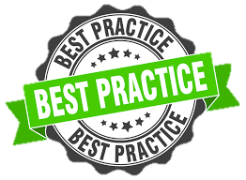
Best Practices
Version control your dbt project
Use separate development and production environments
Use a style guide and code conventions for your project
Use the ref function to infer dependencies
Limit references to raw data from an API
Break complex models up into smaller pieces
Group your models in directories
TEST TEST TEST
Choose your materializations wisely
Limit the data processed when in development
Notes:
All dbt projects should be managed in version control. Git branches should be created to manage development of new features and bug fixes. All code changes should be reviewed by a colleague (or yourself) in a Pull Request prior to merging into master.
Use the dev environment for testing and the prod environment for customer facing (ie analysts and product managers)
Once the code has been checked then release it to prod (snowflake will create a time travel incase you need to revert changes as long as all code is released with out creating new tables)
Go back and reference the style guides that are input throughout all the slides
It also ensures that your current model selects from upstream tables and views in the same environment that you're working in. Always use the ref function when selecting from another model, rather than using the direct relation reference
Columns change in the API and it can mess up the entire downstream if not caught in time … create tests if you must reference raw data
This follows the CTE style guides that models should do one task
Group smaller subtasks into directories that complete an entire model
Views are faster to build, but slower to query compared to tables.
Incremental models provide the same query performance as tables, are faster to build compared to the table materialization, however they introduce complexity into a project.
Use views when creating the code but switch to a table once dev is done

Slide 21

Confused? ASK QUESTIONS

Slide 22
Break & Lab 8
Notes:
DBT working session

